Slide 1
Warehouse Management
Strategic approach to deployment

Slide 2
About Us!
Managing Partner, Guidepath Consulting
Extensive background WMS & TMS
F&O & BC
20 years SCM experience
High velocity handheld (cellular industry)
Food/Bev | Manufacturing | Distribution (3pl & Vertically integrated industries)
10 years consulting
AXR2
AXR3
F&O 7.3 – present
Warehouse Mgmt. | Transportation Mgmt. |Manufacturing

Slide 3
Topics
Enablement
Item & Warehouse
Release to Warehouse
Shipment, Wave, Work ID
Locations
Profile & Zones (LP & non-LP)
Inventory
Cycle Counting, Units
Business Logic
Location directives & Work templates
Printers, media, & scanning

Slide 4
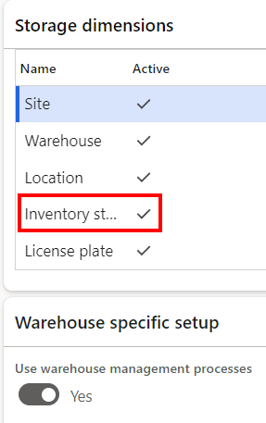
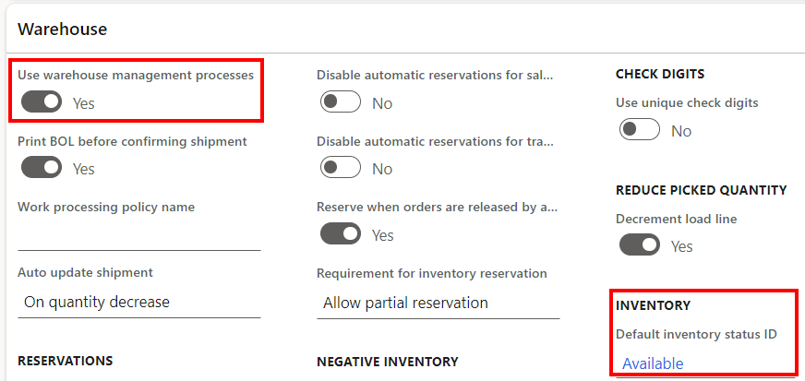
Item Enablement
Item enablement is first & foremost the most important SCM decision you will make leading into an ERP implementation.
You can bypass using WMS if you do not need it now.
Difficult & expensive if you DID NOT enable during the initial engagement.
Future proof company growth & turn it on during the initial implementation
Save floorspace & technical overhead/debt

Slide 5
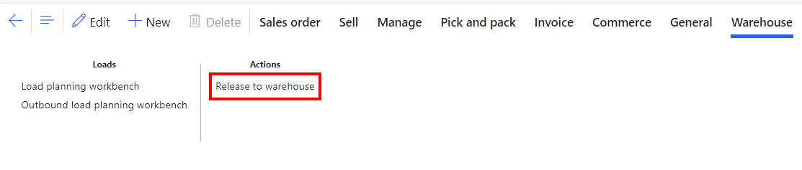
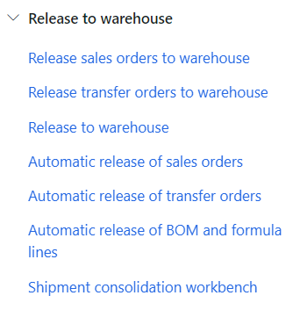
Release to Warehouse
Release to warehouse
Batch
Direct from Sales/Transfer order
Load Planning Workbench
Common misconception
This creates work?
Only creates Shipment ID (outbound/shipping)
The Magic happens on the wave
Understand how you process demand & when that demand should be available for execution. This will drive the method of demand release

Slide 6
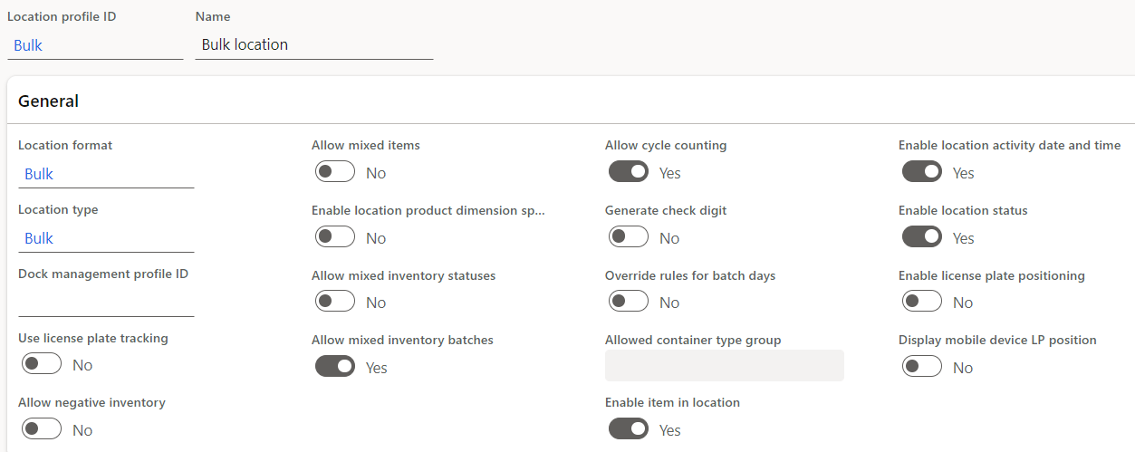
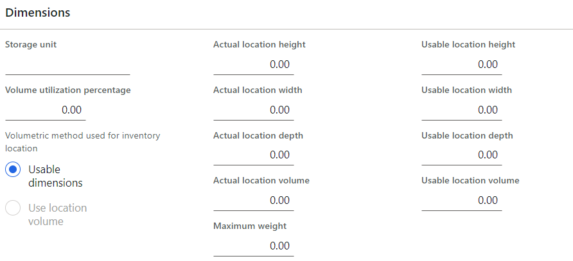
Location Considerations
Avoid 1 (this prevents growth in the opposite direction)
Group by profile
Grouping by profile will help future business logic (directives)
Proper naming can help with interleaving (pick path)
Zones – “Mini warehouses”
Establish zones to make allocation off limits at a higher level
Location profiles are the “brains” of locations

Slide 7
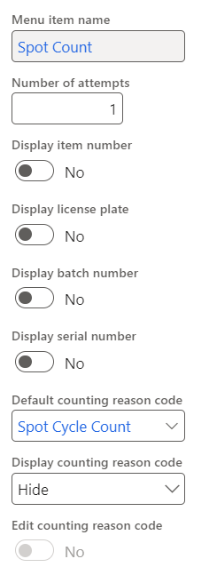
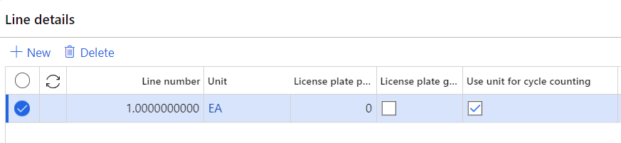
Inventory (cycle Counting)
Item | Location | Spot | Plans
Product confirmation – Unit List View
Let “Pending Review” work for you

Slide 8
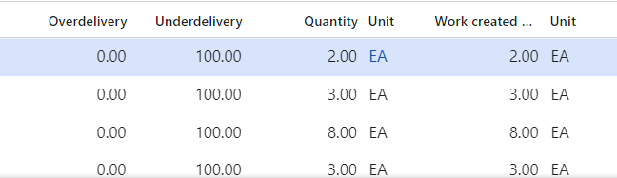
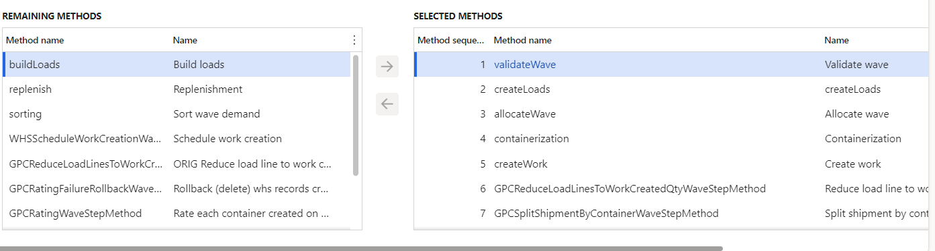
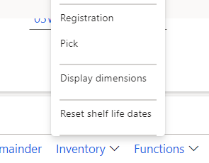
Inventory (Transfer Order)
Apply DIM to the Transfer line
Pick & Unpick
Load Line Qty + Work created Qty

Slide 9
Work Templates
Work Pool
Group work for execution/reporting
Work Priority
In what order do we want warehouse workers executing work
Directive Codes
Ties out to specific location directives
STOP
Upon successful completion stop users & send them to next work ID (segregation of duties)
Work Class
Segregation of duties (mobile device setup)

Slide 10
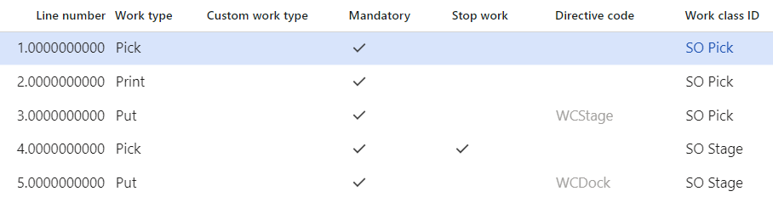
Business Logic Work Templates
Work Templates
Work Pool
Work Priority
Directive Codes
STOP
Work Class

Slide 11
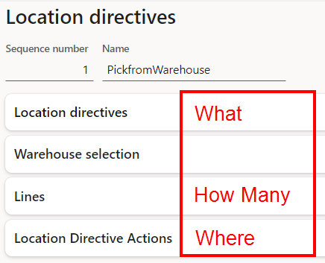
Business Logic Location Directives
Easy thought process
What | How Many | Where
Avoid fixing locations (use profile/zones
Leverage new grouping functions to reduce config footprint
Using proper naming convention

Slide 12
Printing & Scanning
Often underappreciated/overlooked but most important
Remember to make this part of your UAT testing
New functionality + existing tools to help with design
Zebra designer
Labelary
Virtual Printers
Bartender
NiceLable
Dynamic printing!
Wedge scanner programming & mobile device connectivity/app installed

Slide 13
Questions!

